Slide 1

Predicting customer buying behaviour

Slide 2
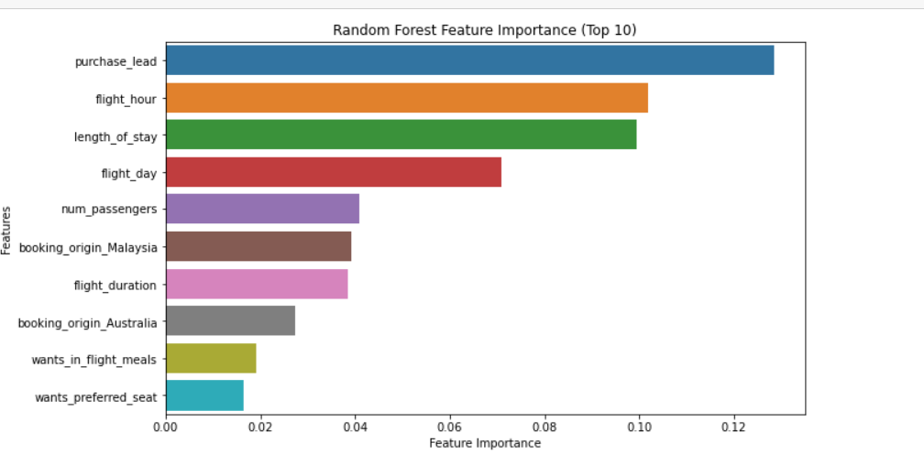
predictive model to understand factors that influence buying behaviour
We have trained the data set with Random forest classifier model with hyperparameter tuning using GridSearch and received
ACCURACY: 0.85
AUC score: 0.796
Purchase_lead
Flight_hour
Length_of_stay
Flight_day
Num_passengers
are the top 5 features which influence
Customer buying behavior

